Slide 1
Welcome Back!
Don’t forget to take a tissue to wipe down your desk…

Slide 2
IB English Language and Literature
6 ELL SL 4
2019 - 2020
Shape of the Week (1):
Lesson 1: Paper 1 Revision
Lesson 2: Paper 1 Revision – Putting it together
Lesson 3: Paper 1 Revision Peer Marking

Slide 3


SCHOOL ASSESSMENT TERM 4
☑ NOTHING!

Slide 4
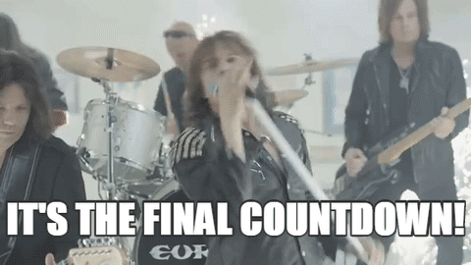

Slide 5
General Outline Term 4
Week 1: 14th-18th September
Lesson 1: Recap ‘Big 5’ and Text Types.
Lesson 2: Planning, paper 1 structure and annotation of example. Complete past paper (HW).
Lesson 3: Marking peer exam paper 1 and go through the mark schemes.
Week 2: 21-25th September
Lesson 1: Revision of main ideas/themes/issues presented in ‘1984’.
Lesson 2: Revision of main ideas/themes/issues presented in ‘COADF’.
Lesson 3: Structure and planning for paper 2. Complete exam questions (HW).

Slide 6
General Outline Term 4
Week 3: 28th Sep- 2nd October
Lesson 1: Marking peer exam paper 2 and go through the mark schemes.
Lesson 2: Exam questions spreadsheet and planning (shared doc).
Lesson 3: Exam questions spreadsheet and planning (shared doc).
Week 4: 5th-9th October
Lesson 1: Final Paper 1 + 2 Revision

Slide 7



We are still a digital classroom!

Slide 8

Homework
Be prepared: Bring Chronicle
Read Context/Key Documents/ Theme and Character Folders on Managebac

Slide 9
Summary Chapter 5
Summarizing what happened to other characters in the village after Santiago’s assassination and the trial that happened against the twins.
Tracking back events happened on the day towards Santiago Nazar’s death from morning till very moment of his death. Short descriptions of episodes occurred building up to Santiago’s death.
On page 101, the narrator insinuates that Santiago did not violate Angela Vicario, making note of how her statement, “He was my perpetrator”, did not take into account specifics (therefore alluding to its falsehood). The statement itself is brash and concise, suggesting that the fact it happened would be accepted by the populace and would therefore validate a fully justifiable motive for the killing.

Slide 10
Summary Chapter 5
The narrator appears to sympathise with Santiago, seen through pages 101-103 in particular. Allusions are made to Santiago’s “innocence”, therefore incriminating Angela Vicario (and as a consequence of what she has said, her brothers as well).
The chapter ends with a graphic account of his death at the hands of the Vicario twins, and his last moments leading to his collapse on the kitchen floor.

Slide 11
Recap ‘Big 5’ and Text Types

Slide 12
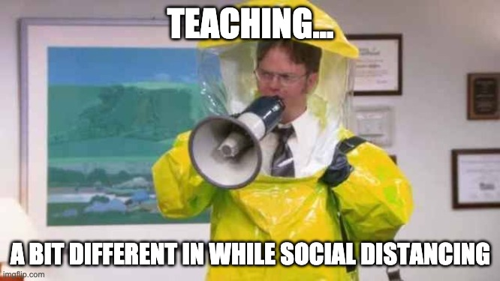
So, I had this super-fun activity planned this morning and then Mrs Hollis told me about new social distancing policy so… back to Firefly I guess. Sorry guys!
Enjoy the meme??? :/

Slide 13
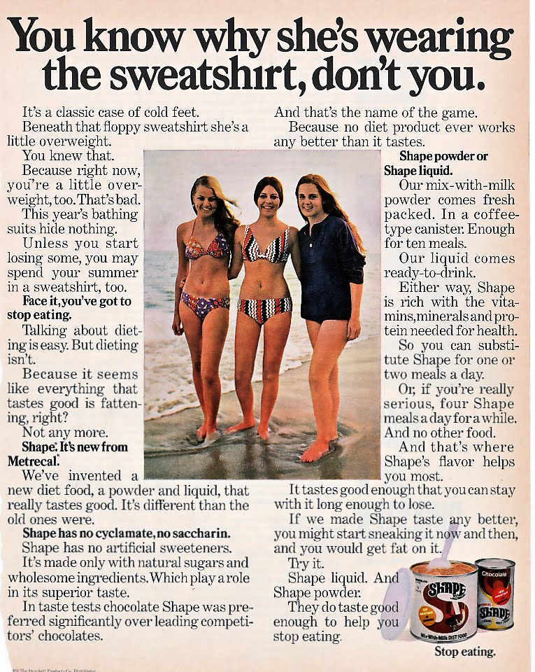
Paper 1 SL Beach Sweatshirt and Practice Paper 1 Shape
Complete the Practice Paper 1 Shape Activities.
Use the other resources to review and guide you. You could also look on Managebac!
Hand in the worksheet Practice Paper 1 Shape to Firefly by 13.35. We will review your response on the board.

Slide 14
The Big 5

Slide 15
Everything is a Text
The best way to become familiar with the 'Big 5' is to practice using it on anything and everything. After all, anything and everything could be considered a text.
The text for this activity is a basketball shoe from 1991. The 'Big 5' will be applied to the image on the next slide, looking at it both in and out of context. Before you view the 'Big 5' analysis of the shoe, ask yourself how the five questions apply to it. Here are a few questions that this activity raises:
Do you think anything and everything could and should be considered a text?
What kinds of difference do you see between your analysis of the shoe and the ones provided in the table below?
How does contextual knowledge add meaning to the text?

Slide 16
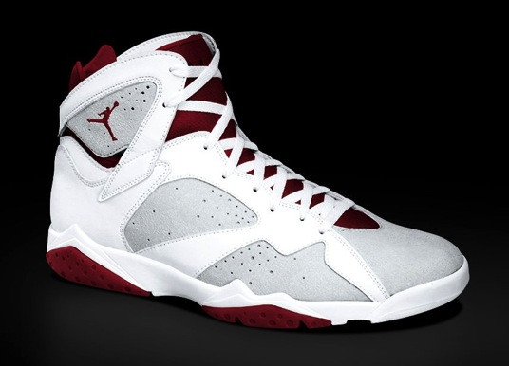
Sample Text: Look at the ‘Out of Context’ column only. Fill this out as someone who does not know about basketball or shoes from the early 90s.

Slide 17
 | Out of Context | In Context
Audience / purpose - Who does the text target? What does the author wish to achieve through the text?
Content / theme - What is literally ‘happening’ in the text? What is it about? What are the main ideas of the text?
Tone / mood - How does the text make you and/or the target audience feel? Describe the atmosphere of the text.

Slide 18
 | Out of Context | In Context
Audience / purpose - | This shoe is intended for people who play basketball. It's purpose is to give good foot support on the court. | This shoe is worn by younger people who like Michael Jordan and want to display their interest in him, the Chicago Bulls and Nike. Its purpose, besides providing foot support, is to make a fashion statement. It shows that the one who wears it is part of a greater street culture.
Content / theme - | The image consists of a basketball shoe. Thematically speaking, one might say that the image comments on sports footwear. | The shoe is about more than playing basketball. It symbolizes one of the greatest marketing partnerships in history between Michael Jordan, the Chicago Bulls and Nike. It comments on the branding of a sports star. (For some people this shoe may be a reminder of the sweatshops in Indonesia where Nike once made these shoes.)
Tone / mood - | The tone of the shoe is sporty. Its never-worn look gives the reader that sense of excitement that one gets after buying something new. | The tone of the shoe is one of success and physicial power. Readers who know about Michael Jordan winning the NBA championships, will associate this shoe with victory.

Slide 19
Stylistic devices - How does the author use language to convey a sentiment or message? What kinds of linguistic tools does he/she employ?
Structure - How is the text organized, literally (i.e. layout/formatting)? What kinds of structural elements of a particular text type do you see?

Slide 20
Stylistic devices - | The bright contrast of the colors red, white and gray adds to the flashy style of the shoe. There is a logo of a man jumping with a basketball. The man in the logo seems to fly with his basketball. | The shoe's style is flashy and smooth. It makes use of the Michael Jordan logo and a contrast of white laces against a red background. The color red may be an allusion to the Chicago Bulls.
Structure - | The shoe is constructed of leather, plastic, rubber and shoe laces. It has a high top for ankle support and air holes for the feet to breath. | The shoe is constructed of leather, plastic, rubber and shoe laces. It's a high top with a pocket of air in the sole.

Slide 21

Applying this method
While the shoe activity is fun for learning the 'Big 5', you will want to practice applying this method to different texts that carry more meaning. Try applying the 'Big 5' to the text opposite. Make a table with 3 columns like the one you’ve seen in the sample.
Change the burden
Tata Motors
2010

Slide 22
Audience / purpose - Who does the text target? What does the author wish to achieve through the text?
Your response:
Sample response:
This text targets Malaysian families who do not have a lot of money. The purpose of this ad is to sell cheap, small cars to those who, until now, could only afford motorcycles. The writer's uses a non-standardized form of English, which is most likely understood by Malaysians and contains influences from the Malaysian language.

Slide 23
Content / theme - What is literally ‘happening’ in the text? What is it about? What are the main ideas of the text?
Your response:
Sample response:
Content-wise the ad depicts an unsafe situation with 5 people on one motorcycle. It shows the safe alternative mode of transportation, a Tata Nano, along with some persuasive text.
Thematically speaking one could say that the ad is about the importance and affordability of safe transportation.

Slide 24
Tone / mood - How does the text make you and/or the target audience feel? Describe the atmosphere of the text.
Your response:
Sample response:
At first the tone of the text is quite ominous, reminding the reader of Malaysian traffic laws and the dangers of the road. This could put the reader in wary mood.
However later the reader comes away with a sense of empowerment, as he/she is reminded of how affordable the solution to this problem is.

Slide 25
Stylistic devices - How does the author use language to convey a sentiment or message? What kinds of linguistic tools does he/she employ?
Your response:
Sample response:
The text is very direct, as it refers to 'you'. Lines like "You can afford it" activate the reader. It makes use of the problem / benefit device often found in ads. Although the image makes use of bright, uplifting colors the expression on the woman's face is rather disconcerting. This juxtaposition might capture the audience's attention.

Slide 26
Structure - How is the text organized, literally (i.e. layout/formatting)? What kinds of structural elements of a particular text type do you see?
Your response:
Sample response:
The text has all of the common structural devices of an ad. It has a heading ('Change the burden'), a copy (the main text), a prominent image (the 5 people on a motorcycle), and a signature (the Tata Nano in the lower right hand corner).

Slide 27

Towards assessment
Paper 1 - The 'Big 5' method of analyzing texts works very well on Paper 1.
  While not every text lends itself well to this method of analysis, you will most likely find three or four aspects relevant.

Slide 28
Target Audience

Slide 29

For whom is the text intended?
This question will sound familiar to any language and literature teacher or student! (IG: TARGET AUDIENCE!!!)
Throughout many forms of assessment, students are expected to comment on how effectively texts reach their target audience.
This question may apply to literary or non-literary texts, unseen texts on Paper 1 or short films analysed for further oral activities.
But how good are we at commenting on target audience?

Slide 30
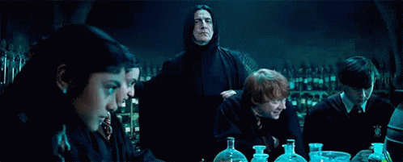
Unfortunately, many Paper 1 samples include phrases such as:
"Text 1 is a poem, so it appeals to people who like poetry," or
"Text 2 is written for men, because it was written by a man."
How do we move away from such simplistic interpretations of texts and shallow analyses of target audience?

Slide 31
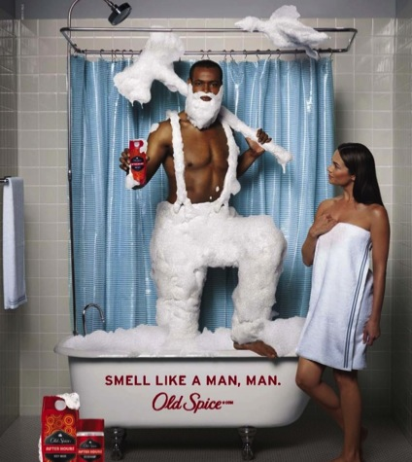
We will focus on a the notion of target audience in relation to a very specific text type: advertisements for grooming products for men, such as this famous one on the right that reads: "Smell like a man, man."
The obvious response to such an ad is that it targets men. This, however, is the kind of simplistic response that is discouraged.
Through a study of context, text and language, we can come to a more sophisticated response to such texts.

Slide 32
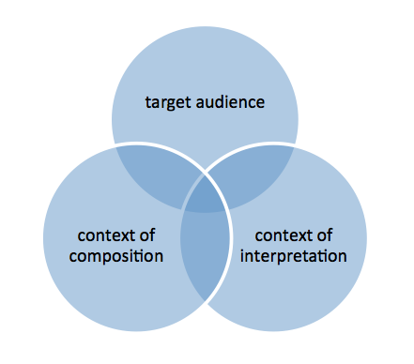
Context
In the diagram opposite you see that there are three agents involved in any kind of communication:
the writer (context of composition)
the reader (context of interpretation)
the kind of person that the writer thinks will read the text (target audience).

Slide 33
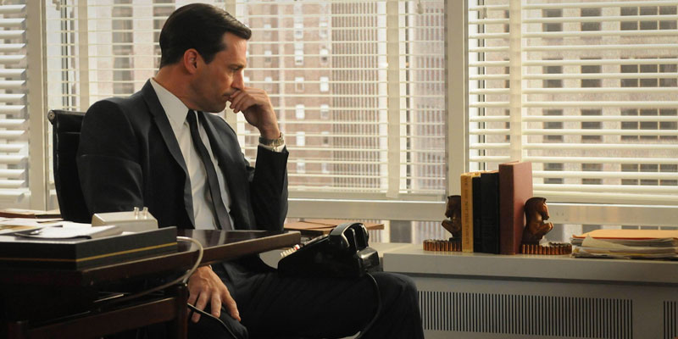
Consider…
Imagine for a moment that you are the writer of ads for men's grooming products, i.e. soaps, shaving creams, deodorants etc.
Your purpose is quite simple: sell as much of your product to as many men as possible. Before you create an ad to sell men's grooming products there are a few facts that you should know about the context of this market:

Slide 34
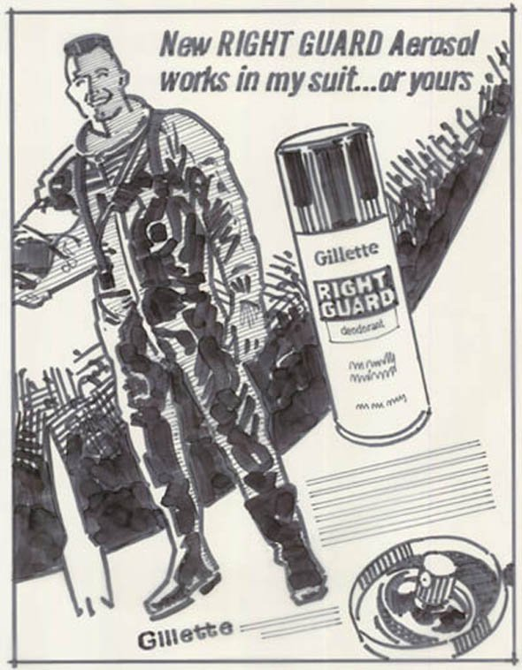
Ideas..
Only 20% of all grooming products on the market are men's grooming products. Women's products account for the other 80%.
Of the people who actually purchase men's grooming products, 70% are women. They are buying for their fathers, sons and husbands.
80% of men's grooming products sold online are actually purchased by men. This is a rather new phenomenon, with the arrival of online shopping.

Slide 35
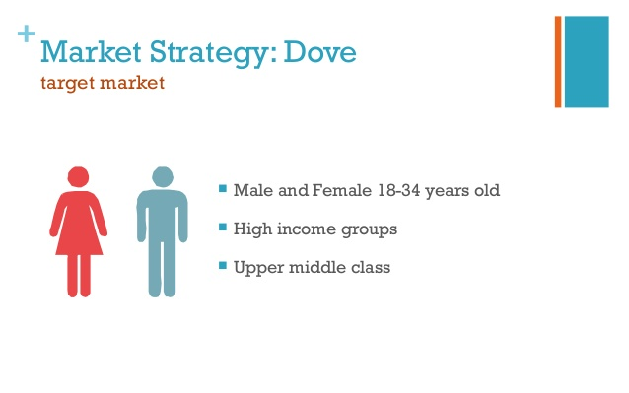
Exercise
The following sets of ads promote the same product to two different target audiences. In each set (L'Oreal, Nivea, and Dove) Ad 1 targets men and Ad 2 targets women.

Slide 36
Use the tables on Handout 2:
These ads target men who... | These ads target women who...
...want to appear tough and strong. | ...want their husband to be a caring father.
...are technical. | ...want to care for their men.
... are competitive. | ...want their men to be like TV stars.
...(other) | ...(other)
...(other) | ...(other)
How would you describe those interested in the first and second ads?
In other words, what qualities describe them and how can these be attributed to the language of the texts?

Slide 37

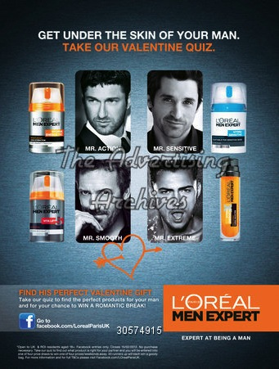
L’Oreal - The ad targets men/women who...

Slide 40

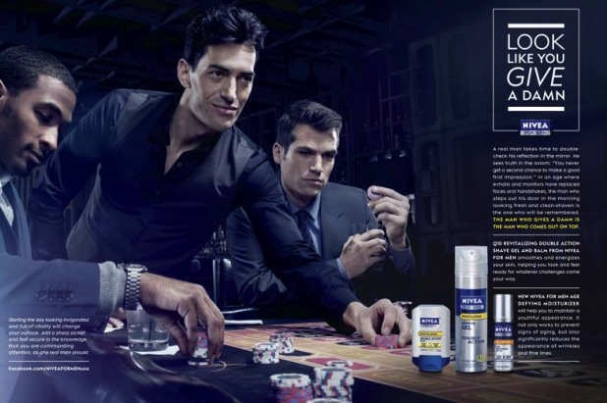
Nivea - The ad targets men/women who...

Slide 43

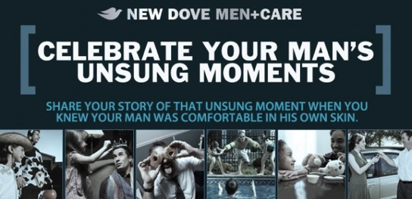
Dove - The ad targets men/women who...

Slide 45


Slide 46
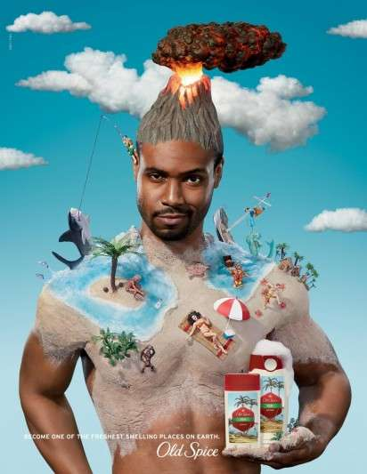
Results: MEN
The ads that target the men are different from ads that target women in that the vocabulary is more technical, such as 'hydra-energetic', 'magnetic' (L'Oreal), 'axiom', 'monitors' (Nivea), 'micromoisture' and 'clinical' (Dove),
The image in the L'Oreal ad, of the man with charcoal under his eyes, gives a very strong, primitive impression. The Dove man is not as macho or formidable.
Notice the language that focuses on competition, such as '1st', 'expert' (L'Oreal), 'come out on top', 'challenge' (Nivea), 'proven' and 'better' (Dove). The men in the Nivea ad seem to be in a casino, which stresses this point.
The slogan of this ad 'give a damn' would never work with women because it is too forceful and harsh.

Slide 47
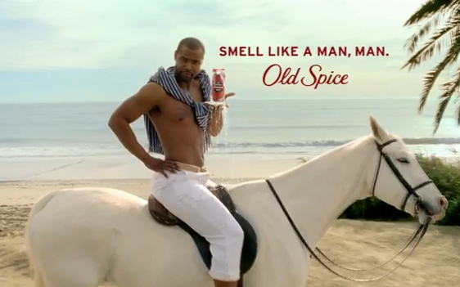
Results: WOMAN
Notice that the word 'sensitive' appears in two of the three ads (L'Oreal and Nivea) that target women. The third (Dove) shows many images of the father being silly and playful with children.
In the L'Oreal ad that targets women, notice the heart with the arrow through it. It seems as if a girl has doodled over a serious ad, while dreaming about these TV stars, comparing them to her husband.
'Get under the skin of your man' has a lot of connotations, suggesting this is her way of finding out more about him.
The Nivea ad suggests that it's a woman's job to take care of her man's skin. If it were left to him, he would do something ridiculous like sticking his head in the freezer. 'What Men Want' seems very instructional towards women.

Slide 48
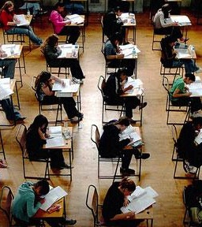
Towards Assessment
FOA - What other industries target the same product to men or women differently? How about car advertisements?
  Despite suggestions that car ads appeal to macho men, you would be surprised how feminine they can be. This is because women are almost always involved in the decision of purchasing a new car. In a presentation of several ads, show how gender stereotypes are reinforced by advertising agencies.
Paper 1 - How will you comment on the different target audiences of the unseen texts that you receive on you Paper 1 exam?
Notice that the strategy in this activity is to focus heavily on the text. If there is a lot of technical language such as 'micromoisture', then you have an argument for concluding that the target audience in technically inclined.
Notice the sentence structure here as well: "the ads target men who are..." This relative clause comes in handy for commenting on target audience.

Slide 49
Homework
Revision!

